Slide 1
Database Management Systems DIET AND WORKOUT ASSISTANT
By
G.Haritha Maithreyee(2110030014)
G.Mahitha Christina(2110030147)
A.Bhavya Sri(2110030067)
G.Vaishnavi(2110030009)
Under the guidance of
Mrs.P.Sree Lakshmi

Slide 2
TOOLS REQUIRED
In this project as a part of DBMS , We need to access data using queries.
DBMS is completely back end software that is used to retrieve or update data.
That is we use MySQL software for queries.

Slide 3
Problem statement and domain
Diet is one of the most important aspects of a healthy lifestyle.
To be fit we should track our workout to keep a check on calories burnt.
The Domain of this project comes under Health Care.

Slide 4
Existing solutions/ Naive solutions
The existing Dietitian System of getting a diet plan is completely manual.
People need to visit their local Dietitian physically to know the suggested diet plan.
The user has to wait for their appointment with the Dietitian.
The user might have to wait for long hours some times.
This makes it very inconvenient for the users to get their diet plan.
They have to wait just to get the information about what they should eat.
https://healthyeating.sfgate.com/what-ate-lose-weight-noom-13771700.html

Slide 5
Aims
Few researchers have studied how these apps affect women with eating disorders in university and college settings.
This research investigates the unintended negative consequences of engaging with these tools.
Method
Data collection sessions comprised three components conducted with 24 participants: survey (demographic and eating disorder symptoms), think-aloud exercise and semi-structured interview.
Thematic analysis was used to analyse data.

Slide 6
Results
Participants reported that diet and fitness apps trigger and exacerbate symptoms by focusing heavily on quantification, promoting overuse and providing certain types of feedback.
Eight themes of negative consequences emerged: fixation on numbers, rigid diet, obsession, app dependency, high sense of achievement, extreme negative emotions, motivation from ‘negative’ messages, and excess competition.
Although these themes were common when users’ focus was to lose weight or eat less, they were also prevalent when users wanted to focus explicitly on eating disorder recovery.

Slide 7
Proposed Algorithm Design Technique
We implement stress free and effective weight loss system.
The user gets to connect with the dietitian and trainer in order to achieve fair weight loss manner.
The dietitian based on the users health conditions prepares a diet plan as it is done offline.
Even the trainer suggests workout as per the body conditions of the user.
We even maintain privacy.

Slide 8
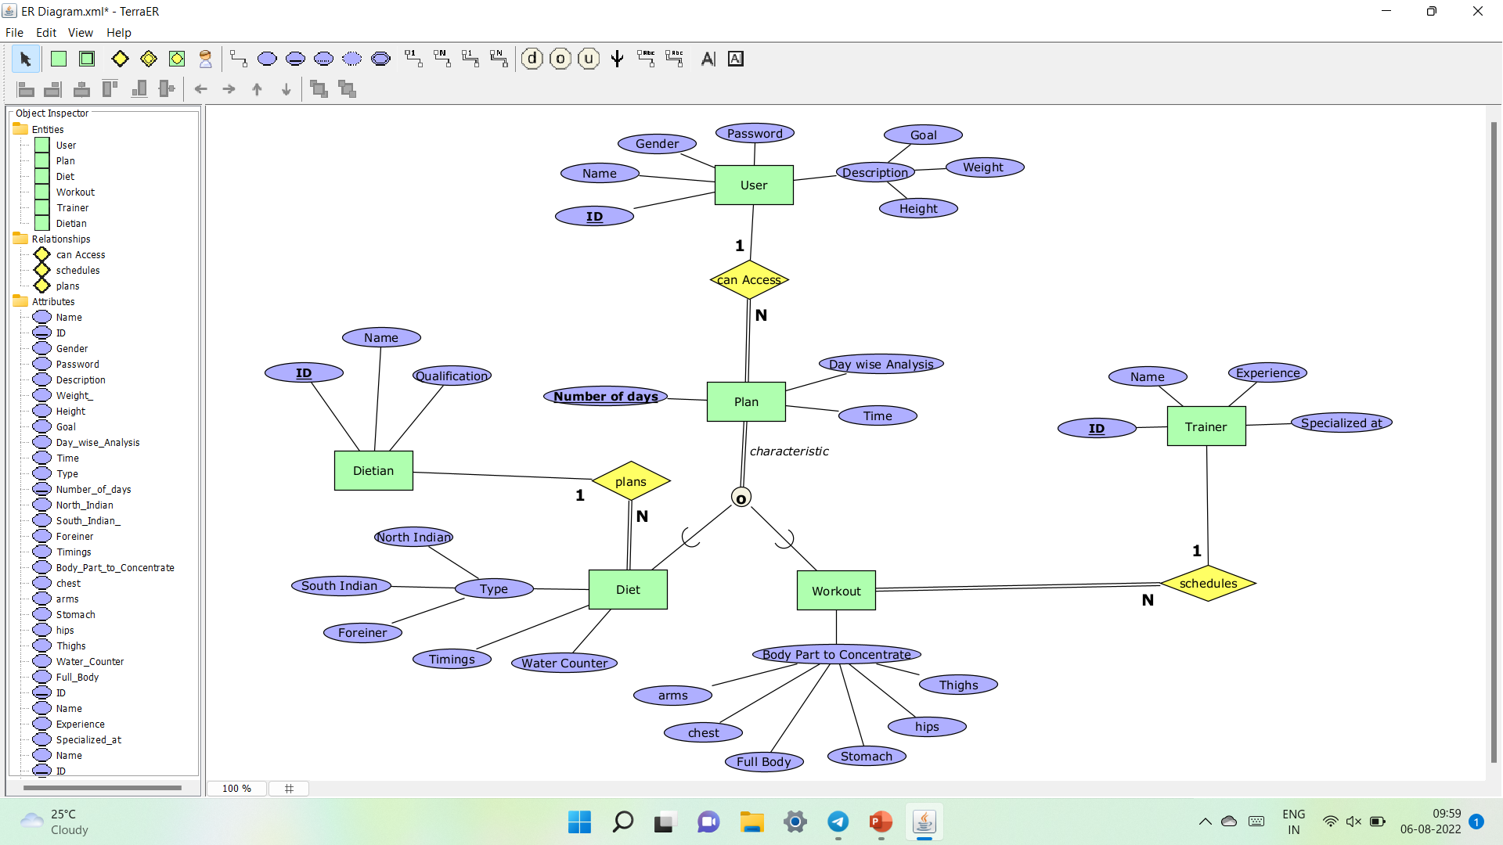
ER Diagram

Slide 9
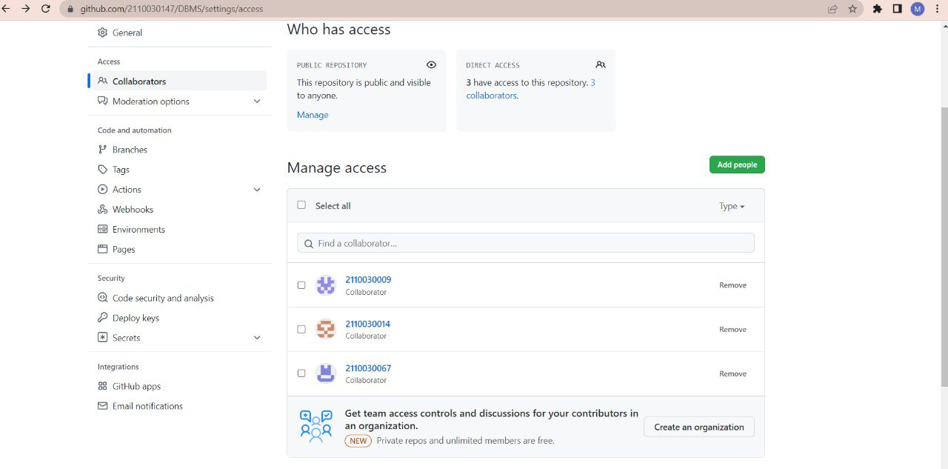
Github setup https://github.com/2110030147/DBMS/settings/access

Slide 10
Division of work among the group members
2110030014 G.Haritha Maithreyee: Research & study.
2110030147 G.Mahitha Christina: Research & study.
2110030009 G.Vaishnavi: PPT & study.
2110030067 A.Bhavya Sri: PPT & study.

